Slide 1

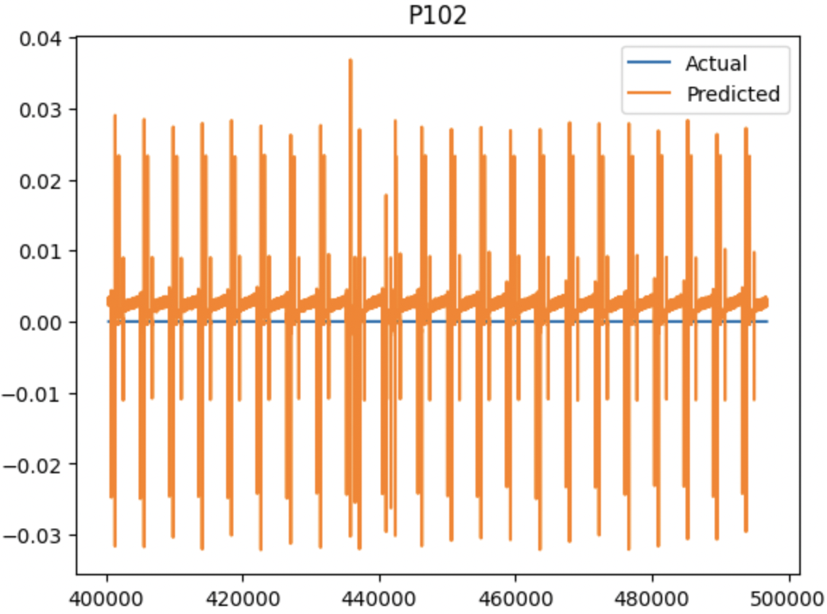

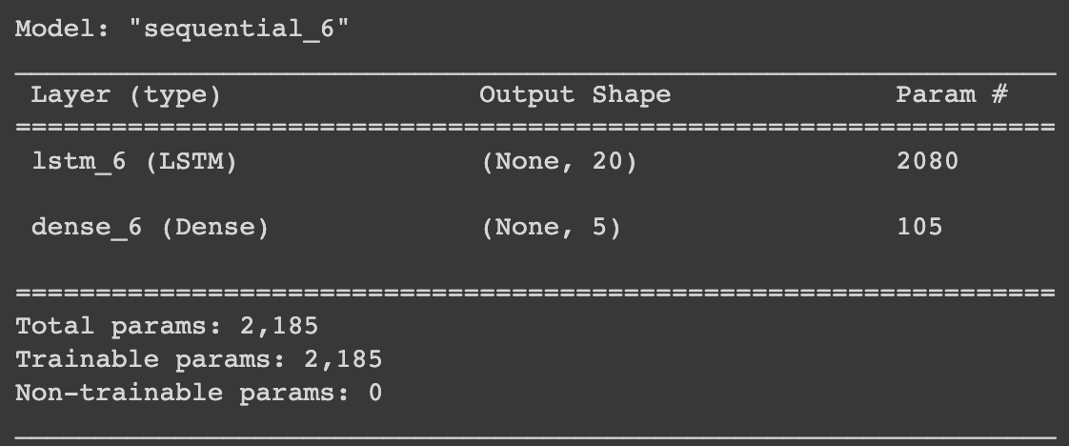
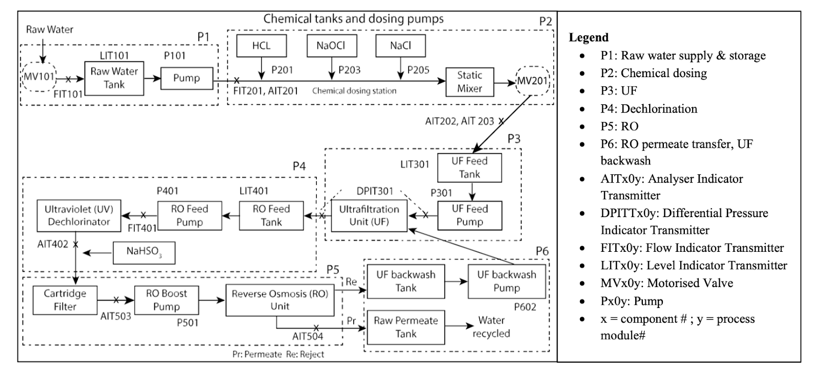
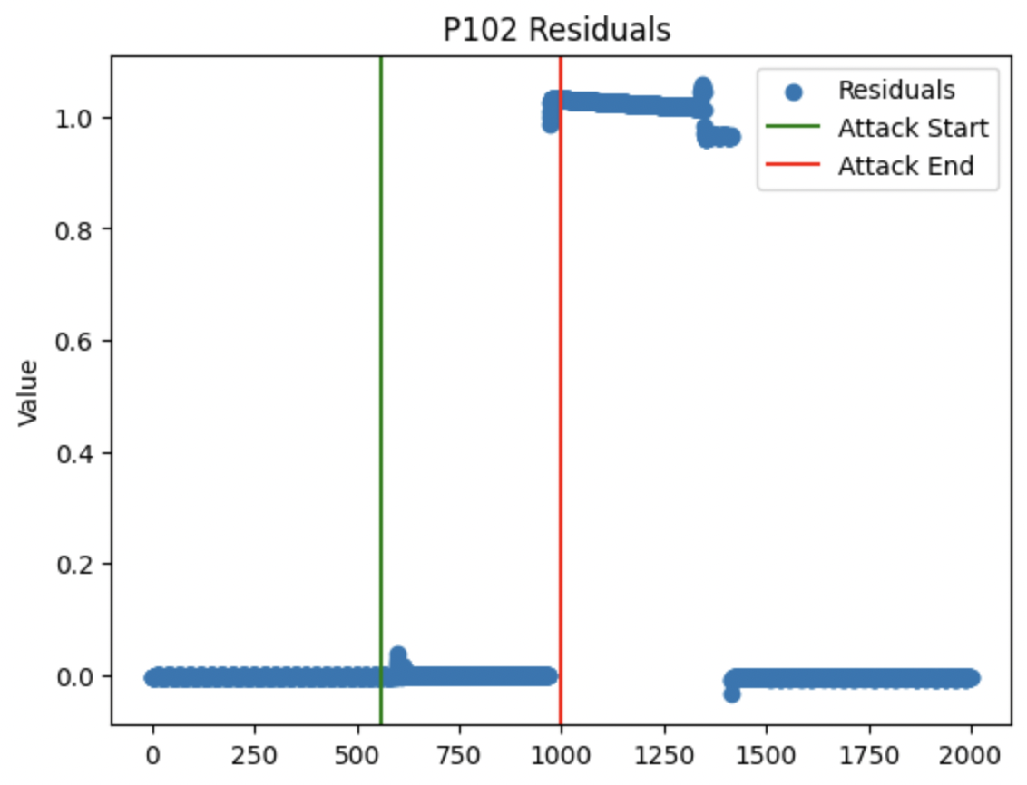
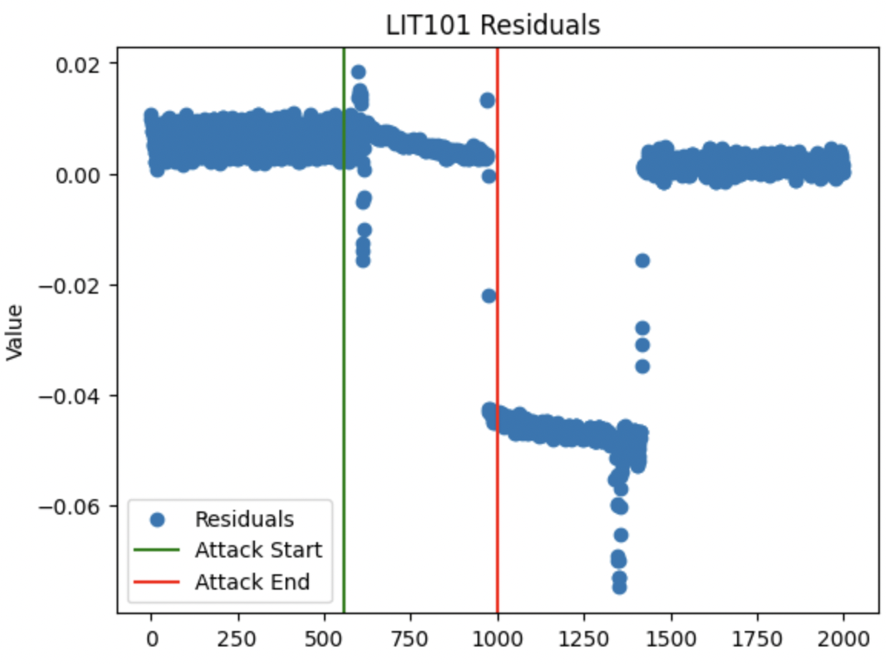
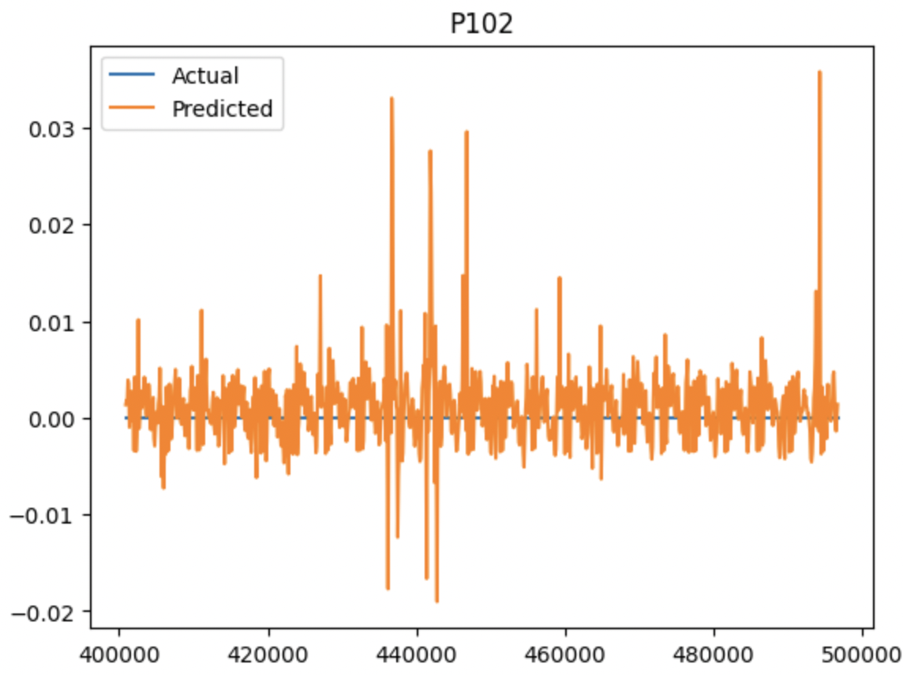
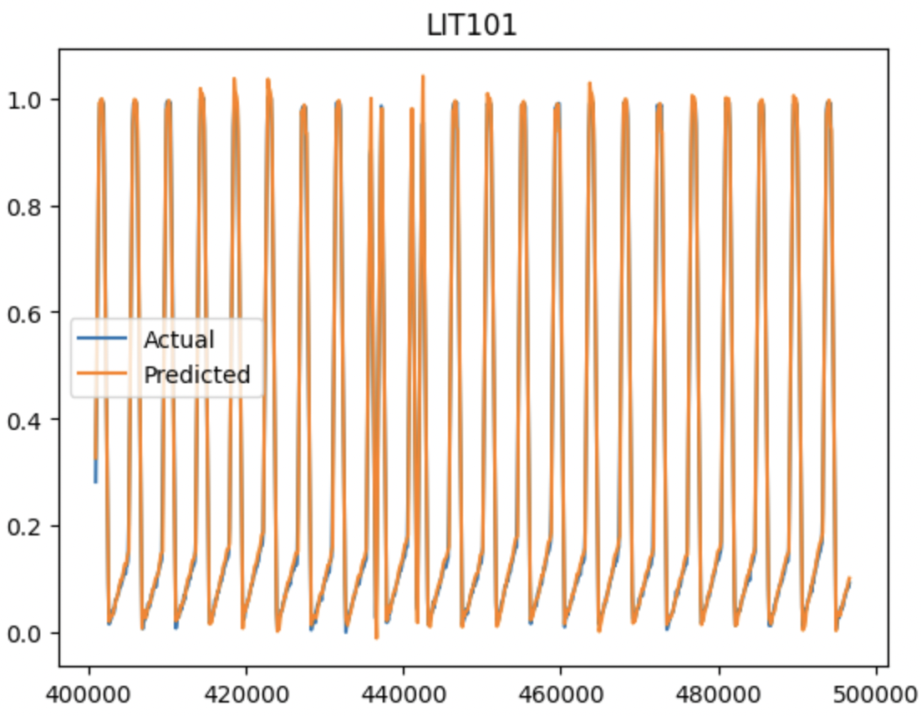
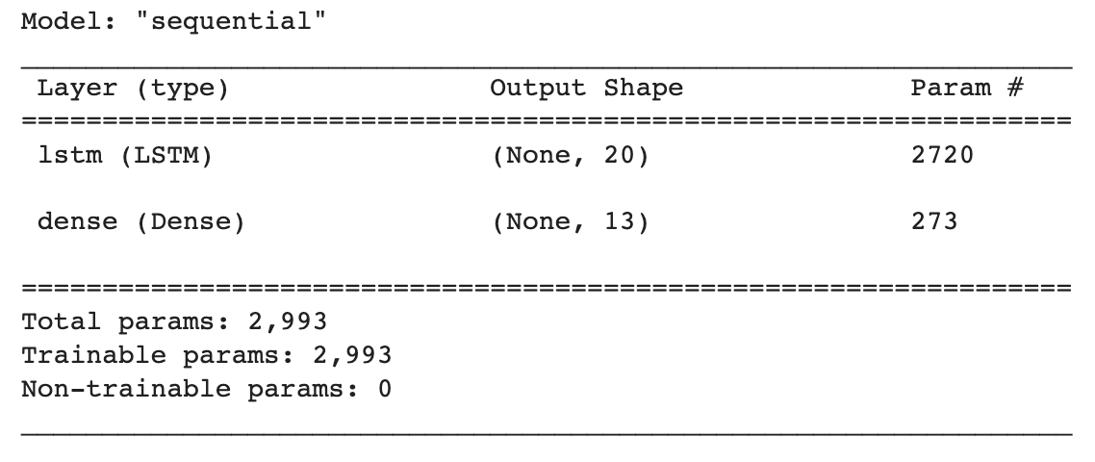
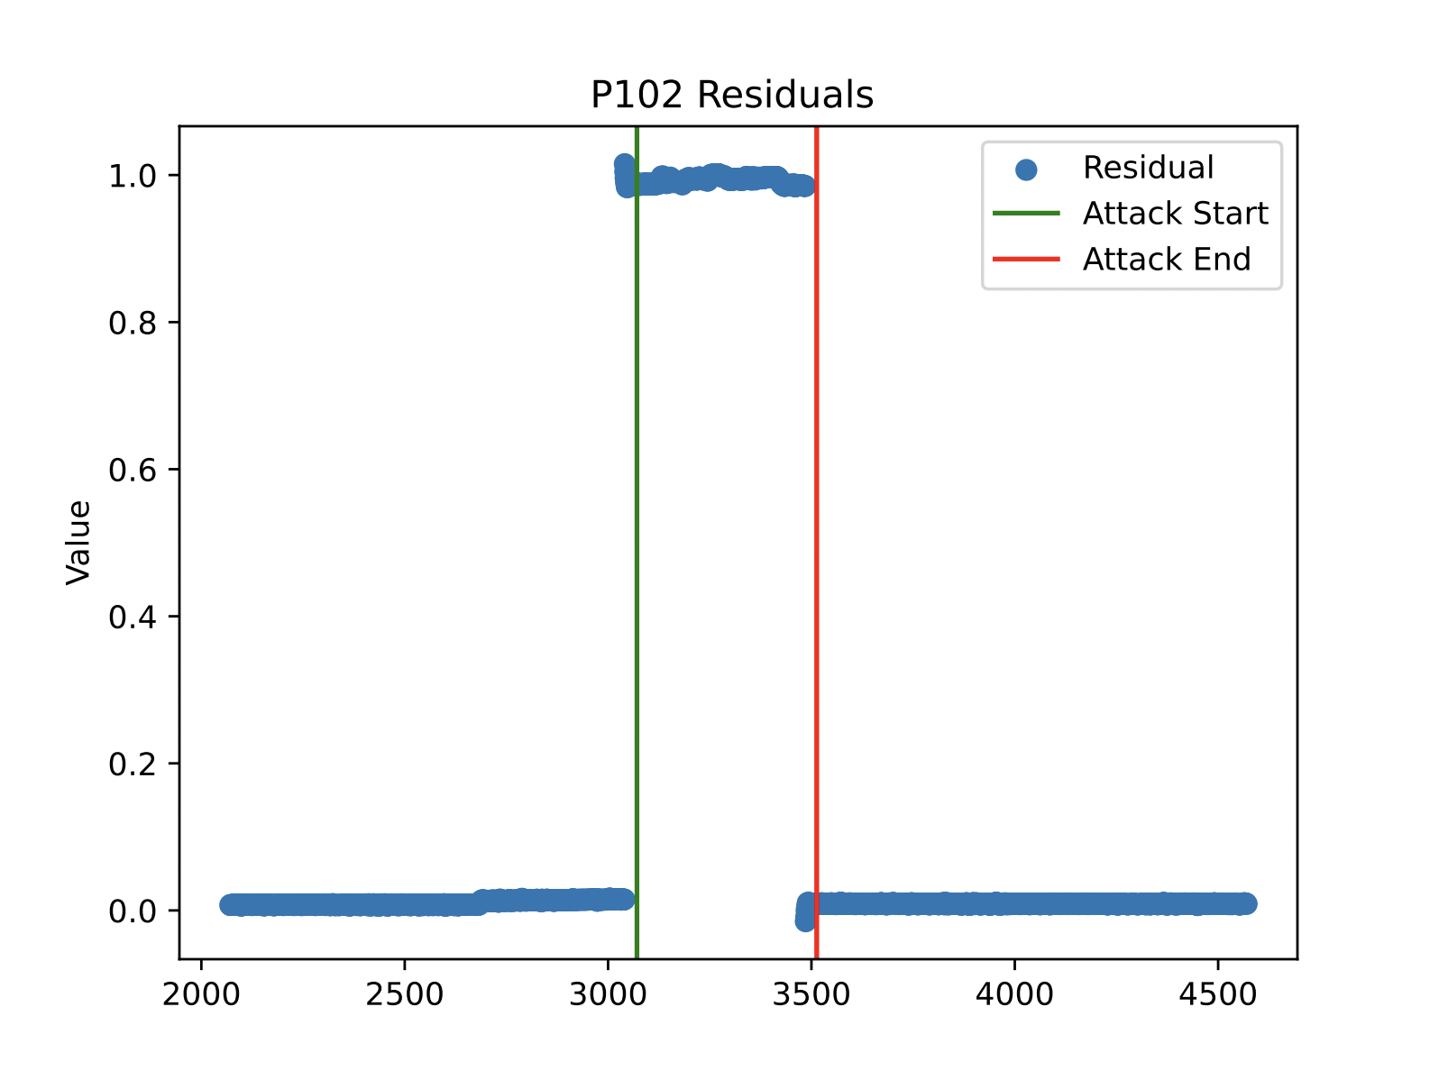
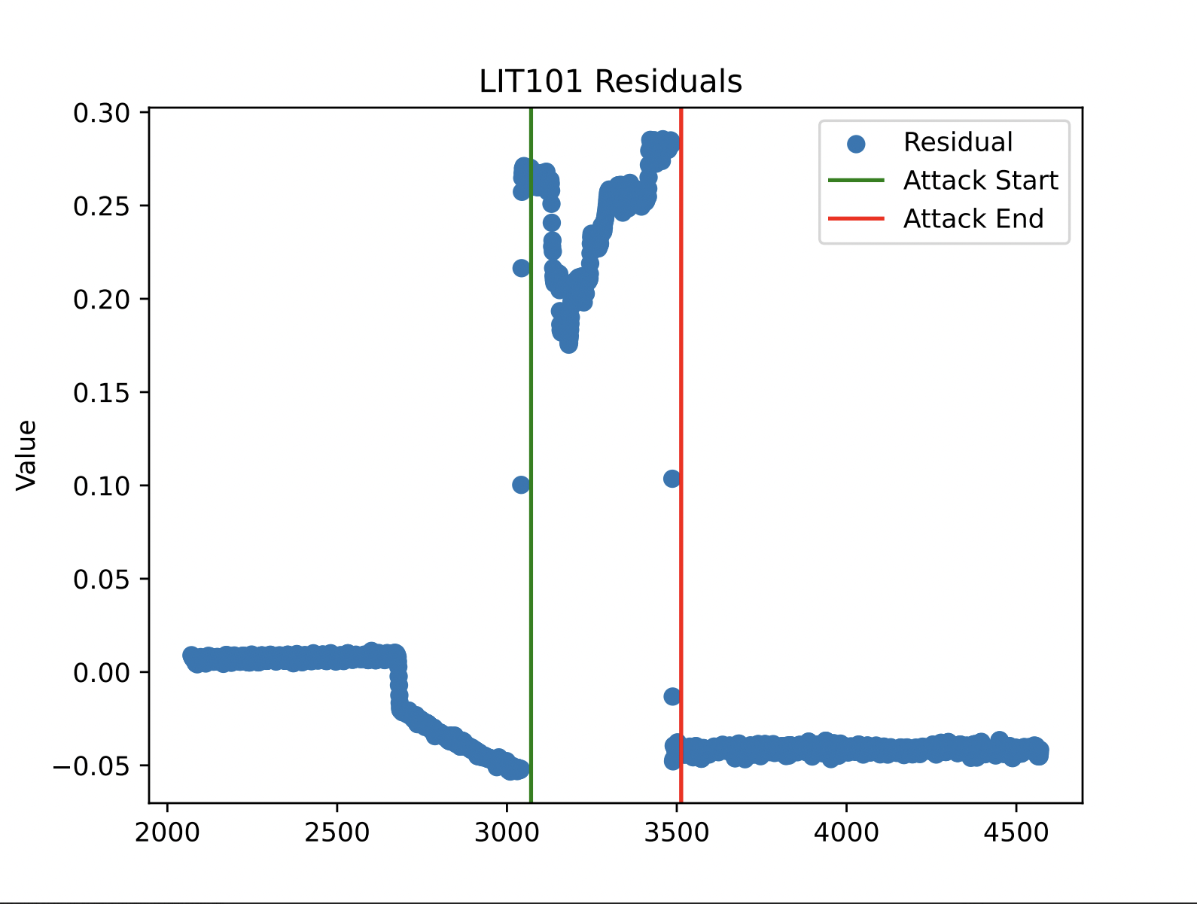
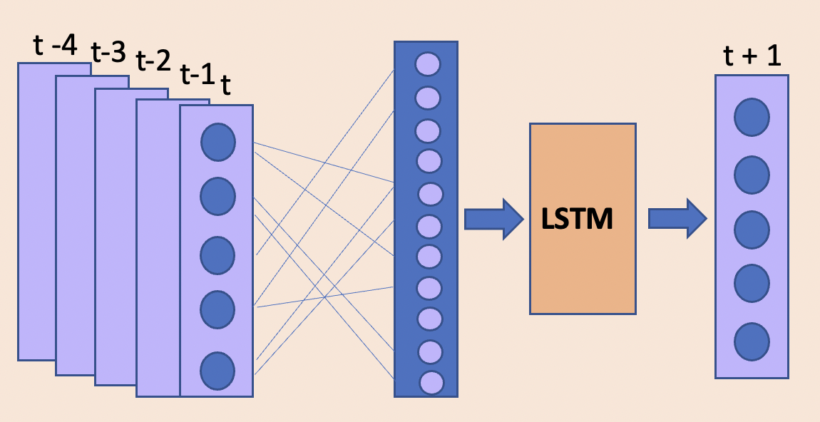
Accurate and Efficient Cyber Attack Detection in Water Filtration Systems using Machine Learning
Chloe Crozier¹, Janhavi Deshpande², Sumanth Pandiri¹, Mathew Werner³, and Dr. Dan Li³
¹ School of Computing, ² School of Mathematical and Statistical Sciences, ³ Department of Industrial Engineering, Clemson University
Introduction
Results
Industrial CPSs are prone to cyber attacks.
Focus is on water filtration systems.
Train LSTM models to detect attacks.
Single-Stage
The model was trained on the 5 sensors of stage 1
It uses a 5 second look back to predict 1 second into the future for each sensor
Predictions for single-stage attacks were the best detected on stage 1
Multi-stage
Method
Two different models.
First model uses 5 sensors from a singular stage.
Second model implements a total of 12 sensors from each of the 6 stages.
This model was trained on 13 sensors, handpicked from each of the stages except stage 4.
It also uses a 5 second look back to predict 1 second in the future.
Conclusion and Future Steps
Decrease the sensitivity of the current model when sensor is not under attack.
Create a LSTM model where one stage predicts itself and the next stage.
References
Goh, J., Adepu, S., Tan, M., & Shan, L. Z.
(2017). Anomaly detection in cyber physical systems using recurrent neural networks. Retrieved March 27, 2023, from
https://ieeexplore.ieee.org/abstract/document/7911887
Al-Abassi, A., Karimipour, H., Dehghantanha, A., & Parizi, R. M. (2020, May 4). An Ensemble Deep Learning-Based Cyber-Attack Detection in
Industrial Control System. Retrieved March 27, 2023, from https://ieeexplore.ieee.org/document/9086038

